Slide 1
ENGLISH 8
UNIT 12. A VACATION ABROAD
SECTION: LANGUAGE FOCUS
(page 119)

Slide 2
Homework correcting
1/ The boy ……..to Miss Lien is Nam.
a) talk b) talking c) to talk
2/ The case …………..green is one dollar.
a) painted b) painting c) to paint
3/ Do you mind ……………me some coffee?
a) get b) getting c) got
4/ Would you mind ……………out your cigarette?
a) put b) putting c) to put
5/ Do you mind if she ……………on the air conditioner?
a) turns b) turning c) to turn
6/ Would you mind if I ……………?
a) smoke b) smoking c) smoked

Slide 3
Combine two sentences into one, using –ing or –ed
1/ The old man is a good doctor. He lives near my house.
→
2/ The book is interesting. The book was written by her
→
3/ The house belongs to my uncle. It is made of wood.
→
4/ The girl is very intelligent. She sits next to me.
→
The old man living near my house is a good doctor.
The book written by her is interesting.
The house made of wood belongs to my uncle.
The girl sitting next to me is very intelligent.

Slide 4
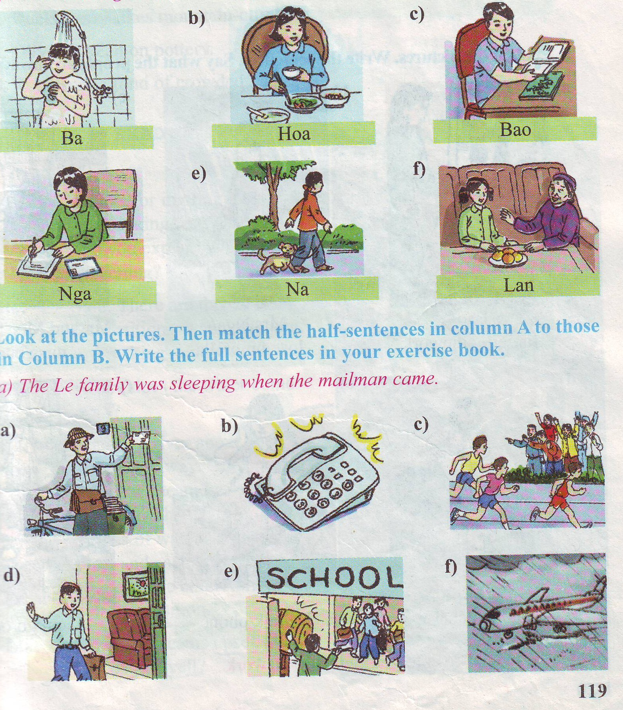
Warm up
Look at the pictures and say what the people are doing
She is writing a letter.
They are talking to each other.

Slide 5
I. The present progressive tense
She is writing a letter now.
Form: S + am/is/are + V-ing…
Dấu hiệu nhận biết: now, at the moment, right now, Look!, Listen! ,v.v...
II. Progressive Tense With Always
Trạng từ always có thể được dùng với thì tiếp diễn để diễn tả:
+ Hành động được lặp đi lặp lại trong quá khứ gây cho người nói dực mình, khó chịu.
She is always talking on the phone
always
S + be + always + V-ing…

Slide 6
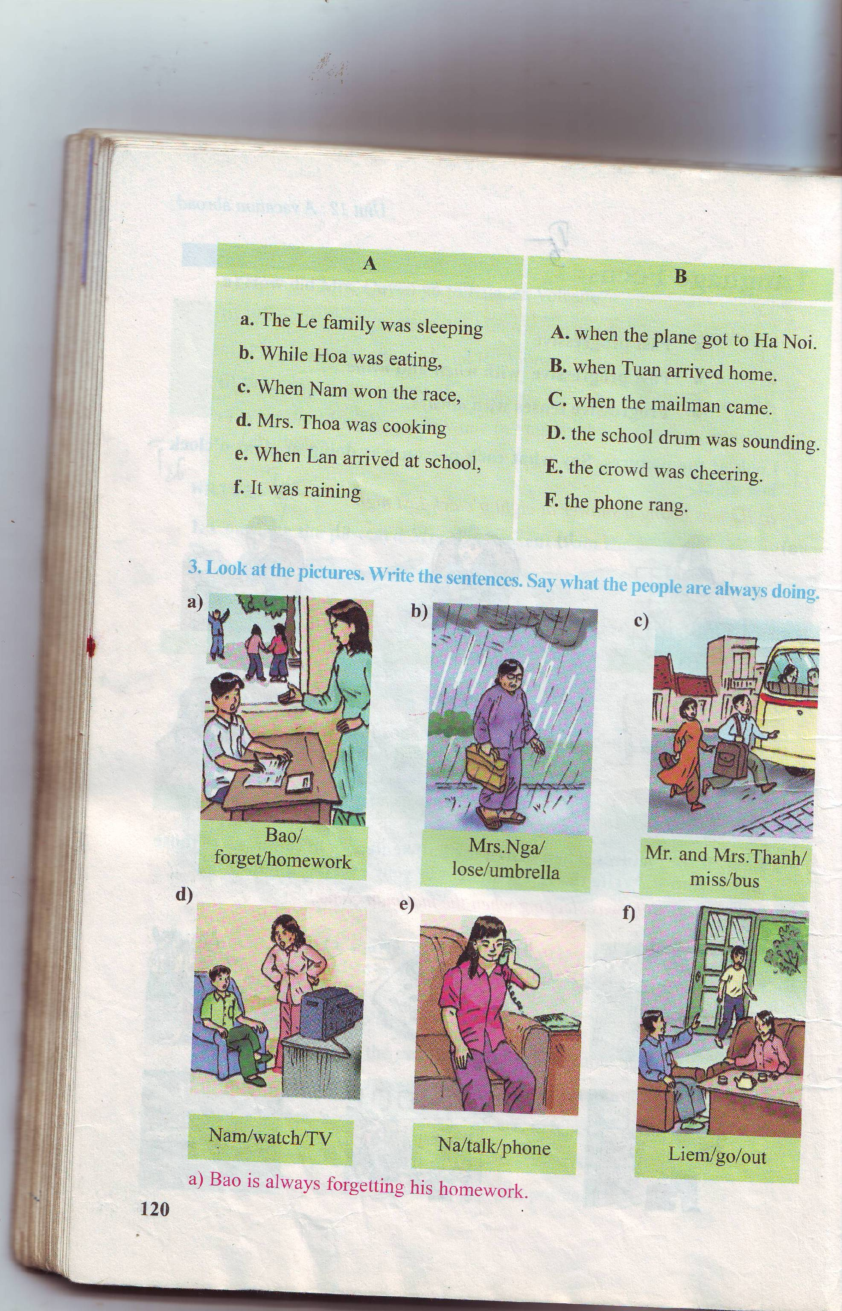
Exercise 3 / 120: Look at the pictures. Write the sentences . Say what the people are always doing .
Bao is always forgetting his homework.
Mrs Nga is always losing her umbrella.
Mr and Mrs Thanh are always missing the bus.
Bao/ forget/ homework
Mrs.Nga/lose/umbrella
Mr. and Mrs.Thanh/miss/bus
Nam/watch/TV
Nam is always watching
TV.
Na is always talking on the phone.
Liem is always going out.
Na/ talk/phone
Liem/go/ out

Slide 7
II.THE PAST PROGRESSIVE TENSE:
Ba is taking a shower now.
Ba was taking a shower at 8 o’clock last night.
Hoa was eating dinner at that time.
Form: S + was/ were + V-ing… .
Use:
- Diễn tả một sự việc đang xảy ra tại một thời điểm xác định trong quá khứ.
Adv:
* at that time, at ( 8 p.m) last night/ 2 days ago, between 8a.m and 9 a.m yesterday, from ( 6 a.m ) to ( 8 a.m ) last Sunday……..When, while

Slide 8
II: Exercise 2:
AT 8 O’CLOCK LAST NIGHT
a)
Ba was taking a shower at...
Hoa was eating dinner.
Bao was reading a comic.
d)
Lan was talking with
her grandmother.
Nga was writing a letter.
Na was walking with her dog.

Slide 9
Exercise 3. Look at the pictures and answer
Who came while the Le family was sleeping?
What happened while Nga was eating?
The Le family was sleeping when the mailman came.
The phone rang while Nga was eating.

Slide 10
III. Past progressive with when and while
when
a. The Le family was sleeping when the mailman came
Be +V-ing
V-ed/V2
Past progressive
when
Past simple
while
b. The phone rang while Nga was eating
V-ed/V2
Be +V-ing
Past simple
while
Past progressive
Ex: My father was playing chess while my mother was sewing.
S + was/ were + V_ing when S + V2/ed
while S + was/ were + V_ing

Slide 11
Look at the picture and match
Mrs.Thoa/cook

Slide 12
Matching
a. The Le family was sleeping
A. when the plane got to Ha Noi
b. While Hoa was eating ,
B. when Tuan arrived home
c. When Nam won the race,
C. when the mailman came
d. Mrs Thoa was cooking.
D.the school drum was sounding
e.When Lan arrived at school,
E. the crowd was cheering
f .It was raining
F. the phone rang.

Slide 13
Write full sentences in your exercise book.
a-C. The Le family was sleeping when the mailman came.
b-F: While Hoa was eating , the phone rang.
c-E : when Nam won the race, the crowd was cheering.
d-B: Mrs Thoa was cooking when Tuan arrived home.
e-D: When Lan arrived at school, the school drum was sounding.
f-A: It was raining when the plane got to Ha Noi.

Slide 14
Homework
A. Choose the best answer:
I was studying _________ the light went out. (when/while)
The boys were playing soccer _________ the girls were skipping(when/while)
My sister _________ the chores now. (is doing/ was/doing)
Tom _________ handing in his notebooks on time. (is always forgetting/ was always forgetting)
B. Supply the correct form of verbs:
The phone (ring) while I (cook).
Nam (take) a shower at 6 o’clock yesterday afternoon.
When I (see) him ,he (sit) asleep in a chair.
What you (do) from 7 to 9 yesterday evening?
Mai (always/ watch) TV.

Slide 15
Thanks for your watching

